Slide 1
Computer Networks
By
Lt Col Ishtiaq Kiani
(10 Sep 12 to 12 Jan 13)

Slide 2
PART 2
Physical Layer

Slide 3
Chapter 5 Analog Transmission
Digital to Analog Conversion
Analog to Analog Conversion
Converting
digital data to a bandpass analog signal is digital-to-analog conversion.
Converting
a low-pass analog signal to a bandpass analog signal is analog-to-analog
conversion.

Slide 4
Digital to Analog Conversion

Slide 5
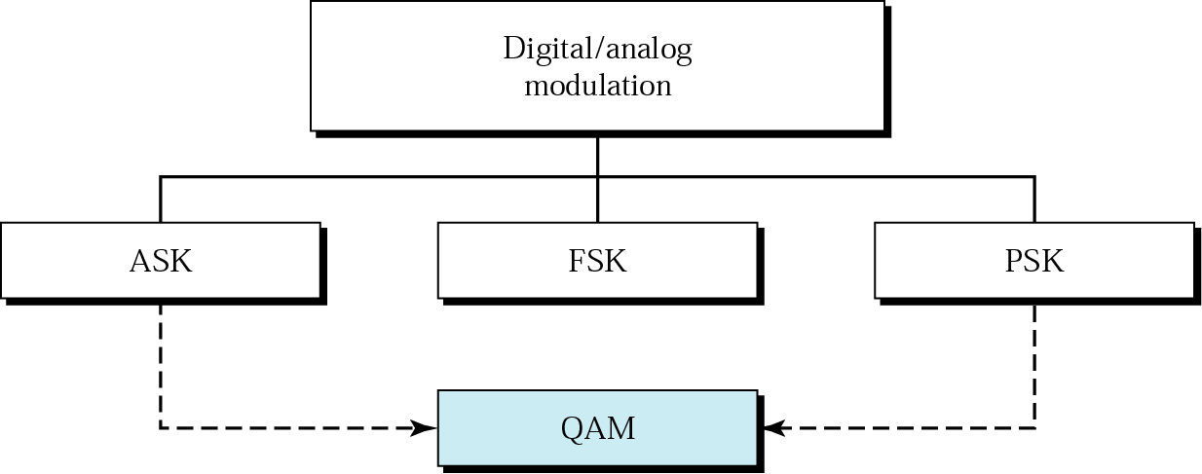
Digital to Analog Conversion
Ask (Amplitude shift key), Fsk (Frequency shift key), Psk (Phase shift key)
QAM: is the most efficient of these options and is the mechanism commonly used today, combines changing both the amplitude and phase, called quadrature amplitude modulation (QAM).

Slide 6
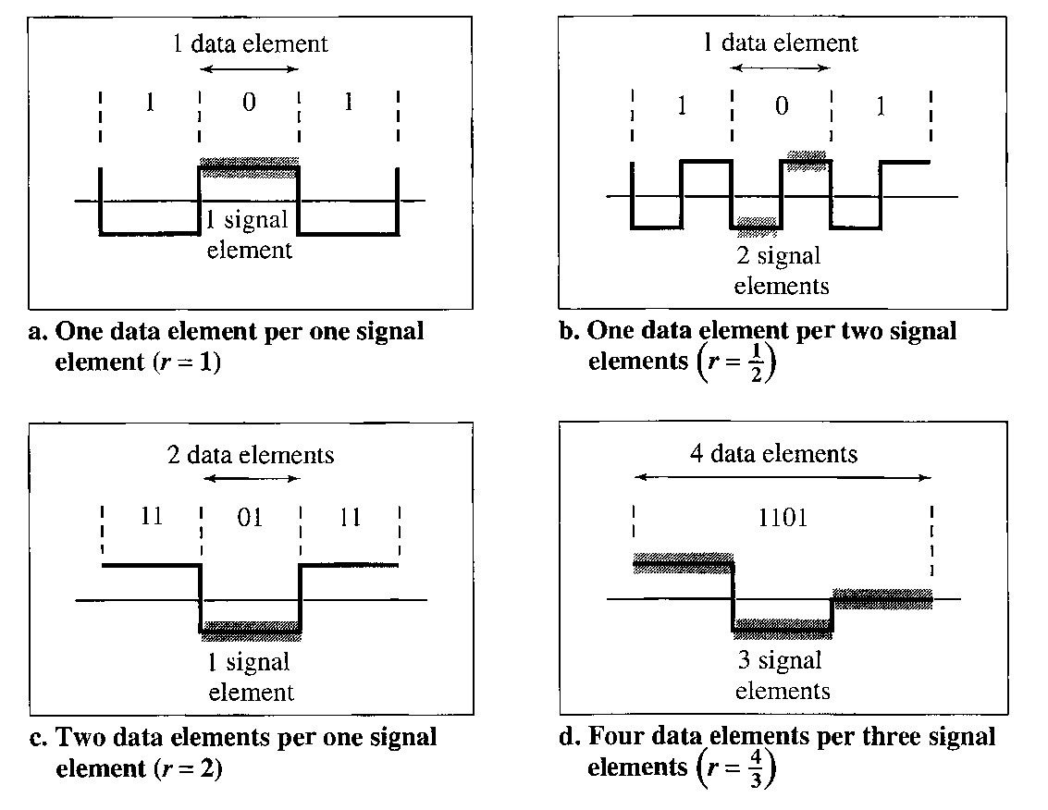
Digital to Analog Conversion
Basic Aspects
Signal element verses Data element

Slide 7
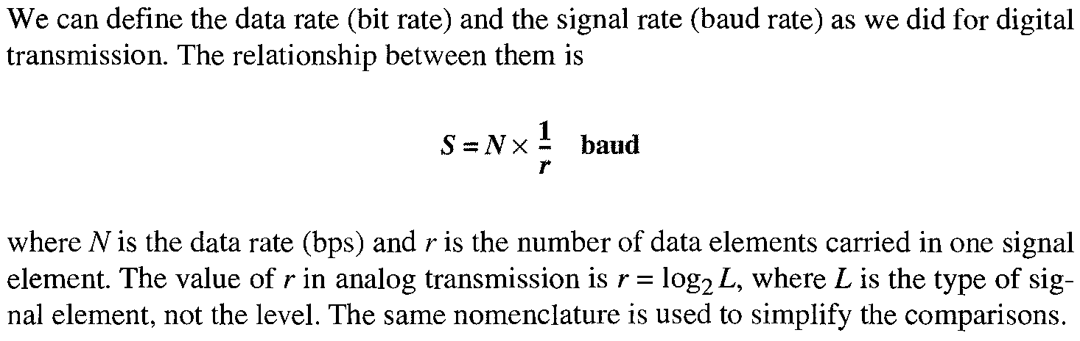
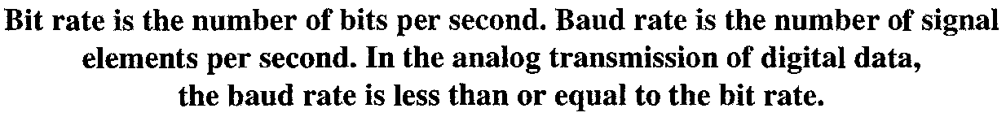
Digital to Analog Conversion
Basic Aspects
Data rate verses Signal Rate

Slide 8
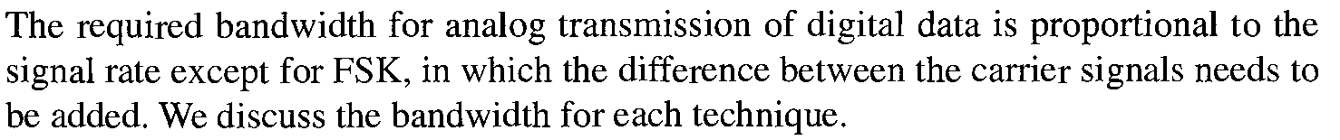
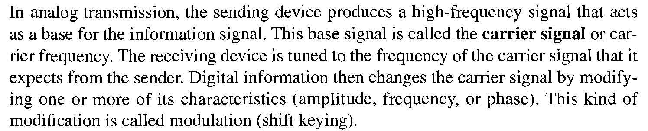
Digital to Analog Conversion
Basic Aspects
Bandwidth
Carrier Signal

Slide 9
Digital to Analog Conversion
Amplitude Shift Keying (ASK)

Slide 10
Digital to Analog Conversion
Bandwidth of ASK

Slide 11
Digital to Analog Conversion
Frequency Shift Keying (ASK)

Slide 12
Digital to Analog Conversion
Bandwidth of FSK

Slide 13
Digital to Analog Conversion
Phase Shift Keying (PSK)

Slide 14
Digital to Analog Conversion
Bandwidth of PSK

Slide 15
Digital to Analog Conversion
PSK Constellation

Slide 16
Digital to Analog Conversion
Quadrature PSK

Slide 17
Digital to Analog Conversion
Q-PSK Constellation

Slide 18
Digital to Analog Conversion
8-PSK Constellation

Slide 19
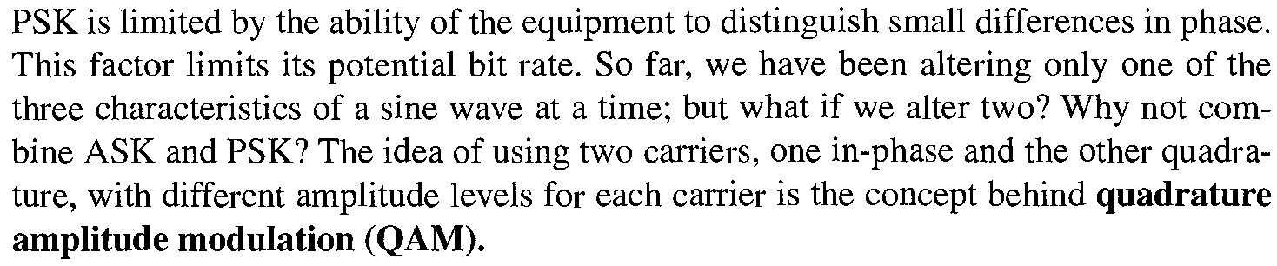
Digital to Analog Conversion
Quaderature Amplitude Modulation

Slide 20
Digital to Analog Conversion
4-QAM and 8-QAM Constellation

Slide 21
Digital to Analog Conversion
8-QAM Signal

Slide 22
Digital to Analog Conversion
16-QAM Constellation

Slide 23
Digital to Analog Conversion
Bit Rate and Baud Rate

Slide 24
Digital to Analog Conversion
Bit Rate and Baud Rate

Slide 25
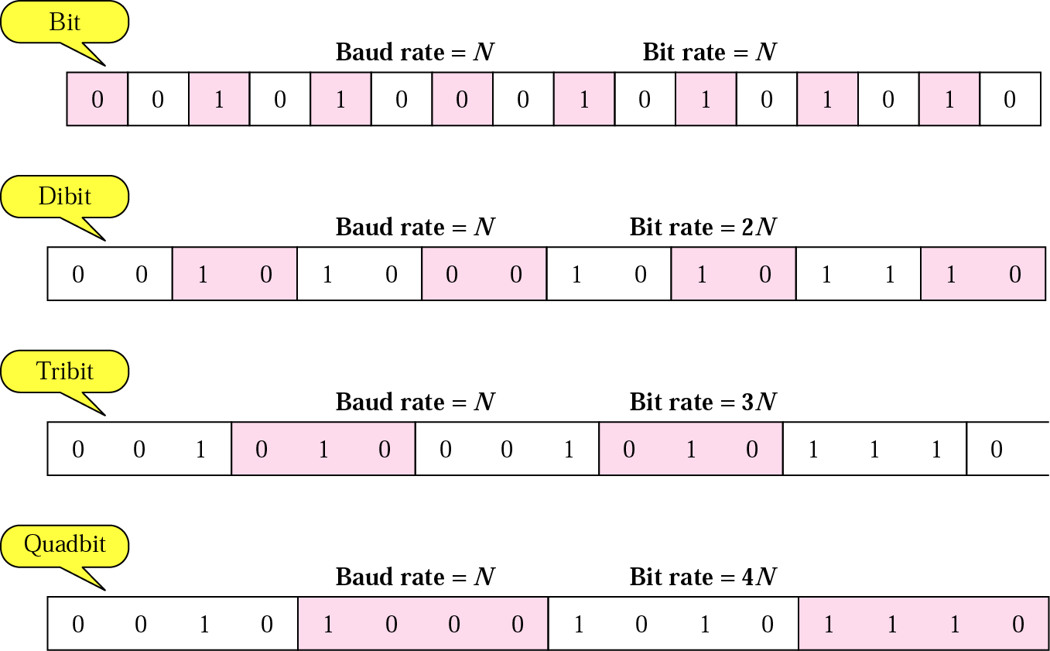
Digital to Analog Conversion
Bit Rate and Baud Rate

Slide 26
Digital to Analog Conversion
Bit Rate and Baud Rate
Modulation | Units | Bits/Baud | Baud rate | Bit Rate
ASK, FSK, 2-PSK | Bit | 1 | N | N
4-PSK, 4-QAM | Dibit | 2 | N | 2N
8-PSK, 8-QAM | Tribit | 3 | N | 3N
16-QAM | Quadbit | 4 | N | 4N
32-QAM | Pentabit | 5 | N | 5N
64-QAM | Hexabit | 6 | N | 6N
128-QAM | Septabit | 7 | N | 7N
256-QAM | Octabit | 8 | N | 8N

Slide 27
Analog to Analog Conversion

Slide 28
Analog to Analog Conversion

Slide 29
Analog to Analog Conversion
Amplitude Modulation

Slide 30
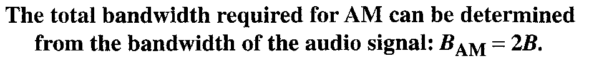
Analog to Analog Conversion
AM Bandwidth

Slide 31
Analog to Analog Conversion
AM Band Allocation

Slide 32
Analog to Analog Conversion
Frequency Modulation

Slide 33
Analog to Analog Conversion
FM Bandwidth

Slide 34
Analog to Analog Conversion
FM Band Allocation

Slide 35
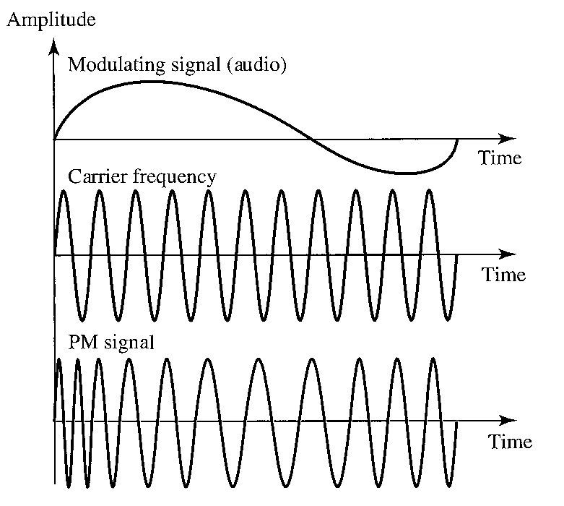
Analog to Analog Conversion
Phase Modulation

Slide 36
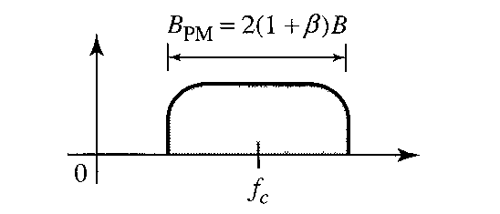
Analog to Analog Conversion
PM Bandwidth

